Slide 1
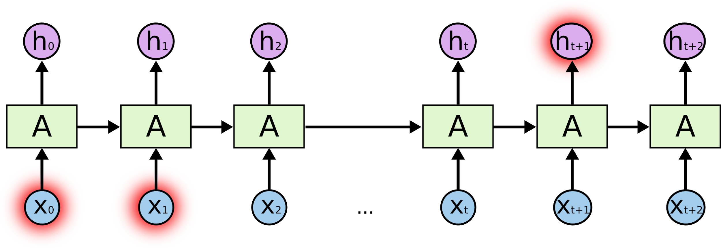


Lab 12
RNN
With TF 1.0!
Sung Kim <hunkim+ml@gmail.com>
Code: https://github.com/hunkim/DeepLearningZeroToAll/

Slide 2

Call for comments
Please feel free to add comments directly on these slides
Other slides: https://goo.gl/jPtWNt
Picture from http://www.tssablog.org/archives/3280

Slide 3
Lab 12-1
RNN Basics
With TF 1.0!
Sung Kim <hunkim+ml@gmail.com>
Code: https://github.com/hunkim/DeepLearningZeroToAll/

Slide 4

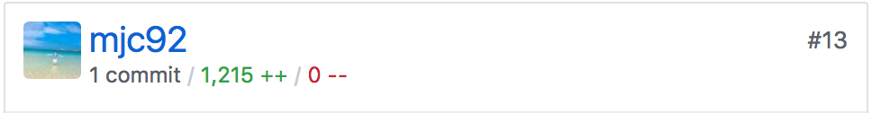
https://github.com/hunkim/DeepLearningZeroToAll/

Slide 5
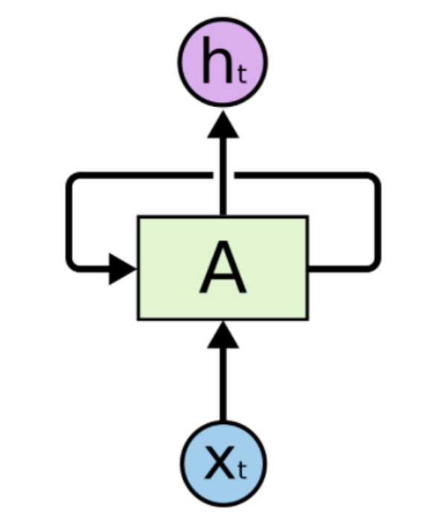
RNN in TensorFlow
cell = tf.contrib.rnn.BasicRNNCell(num_units=hidden_size)
... outputs, _states = tf.nn.dynamic_rnn(cell, x_data, dtype=tf.float32)
https://github.com/hunkim/DeepLearningZeroToAll/blob/master/lab-12-0-rnn_basics.ipynb

Slide 6
RNN in TensorFlow
cell = tf.contrib.rnn.BasicRNNCell(num_units=hidden_size)
cell = tf.contrib.rnn.BasicLSTMCell(num_units=hidden_size) ... outputs, _states = tf.nn.dynamic_rnn(cell, x_data, dtype=tf.float32)
https://github.com/hunkim/DeepLearningZeroToAll/blob/master/lab-12-0-rnn_basics.ipynb

Slide 7
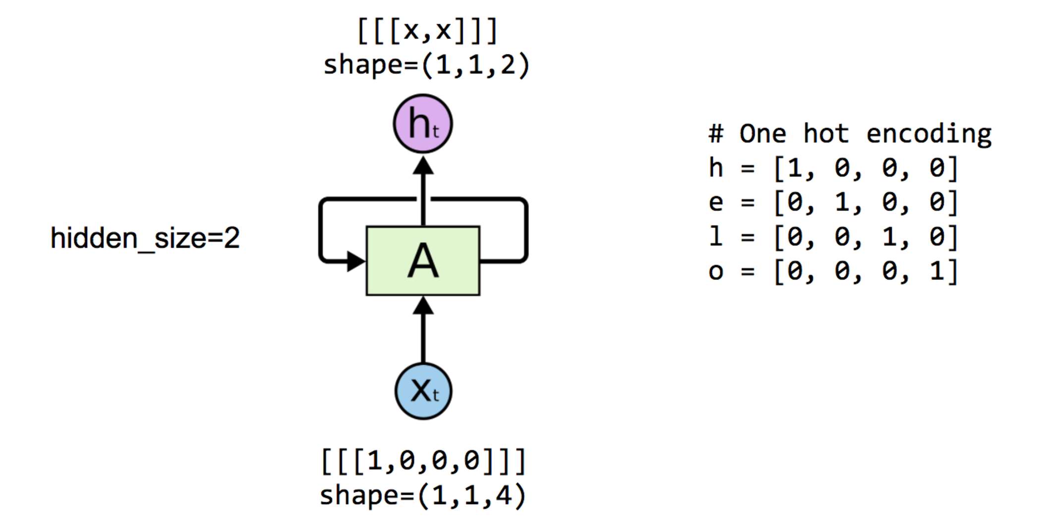
One node: 4 (input-dim) in 2 (hidden_size)

Slide 8
One node: 4 (input-dim) in 2 (hidden_size)

Slide 9
One node: 4 (input-dim) in 2 (hidden_size)
# One cell RNN input_dim (4) -> output_dim (2) hidden_size = 2 cell = tf.contrib.rnn.BasicLSTMCell(num_units=hidden_size) x_data = np.array([[[1,0,0,0]]], dtype=np.float32)
outputs, _states = tf.nn.dynamic_rnn(cell, x_data, dtype=tf.float32) sess.run(tf.global_variables_initializer()) pp.pprint(outputs.eval())
array([[[-0.42409304, 0.64651132]]])
https://github.com/hunkim/DeepLearningZeroToAll/blob/master/lab-12-0-rnn_basics.ipynb

Slide 10
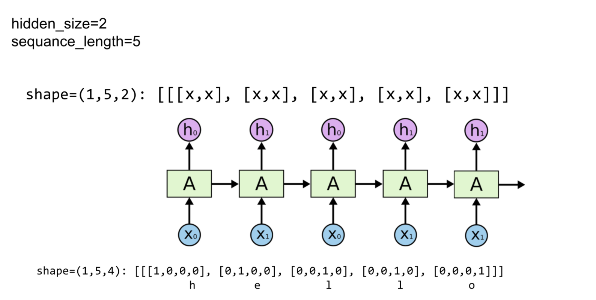
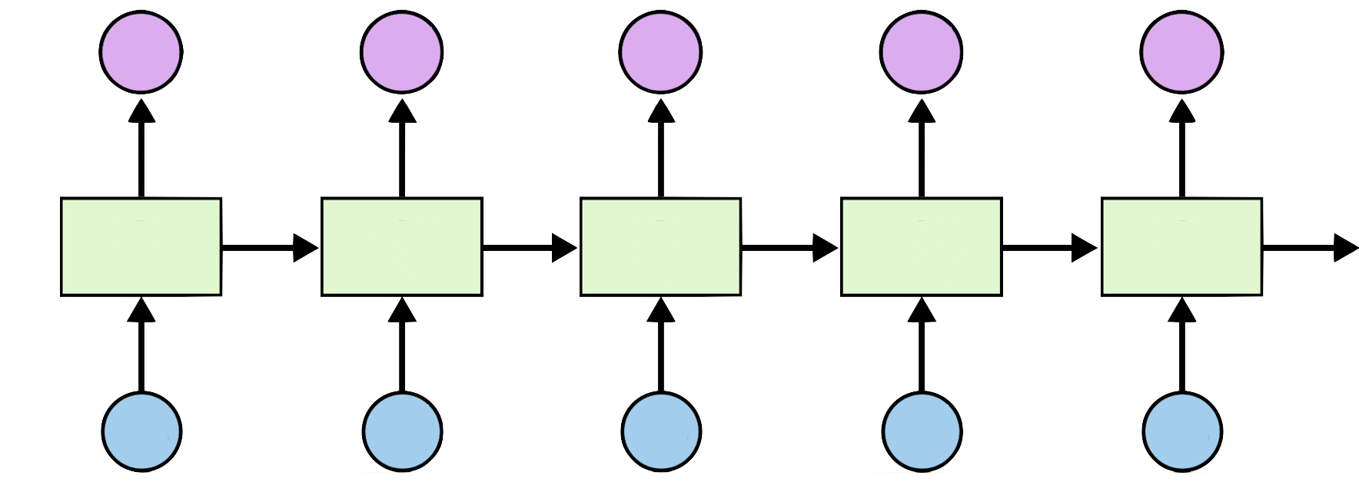
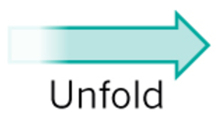
Unfolding to n sequences
Hidden_size=2
sequence_length=5
https://github.com/hunkim/DeepLearningZeroToAll/blob/master/lab-12-0-rnn_basics.ipynb

Slide 11
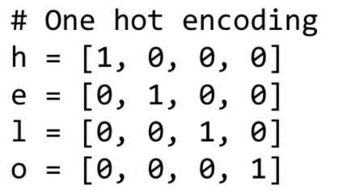
Unfolding to n sequences
# One cell RNN input_dim (4) -> output_dim (2). sequence: 5 hidden_size = 2 cell = tf.contrib.rnn.BasicLSTMCell(num_units=hidden_size) x_data = np.array([[h, e, l, l, o]], dtype=np.float32) print(x_data.shape) pp.pprint(x_data) outputs, states = tf.nn.dynamic_rnn(cell, x_data, dtype=tf.float32) sess.run(tf.global_variables_initializer()) pp.pprint(outputs.eval())
X_data = array
([[[ 1., 0., 0., 0.], [ 0., 1., 0., 0.], [ 0., 0., 1., 0.], [ 0., 0., 1., 0.], [ 0., 0., 0., 1.]]], dtype=float32) Outputs = array
([[[ 0.19709368, 0.24918222], [-0.11721198, 0.1784237 ], [-0.35297349, -0.66278851], [-0.70915914, -0.58334434], [-0.38886023, 0.47304463]]], dtype=float32)
Hidden_size=2
sequence_length=5
https://github.com/hunkim/DeepLearningZeroToAll/blob/master/lab-12-0-rnn_basics.ipynb

Slide 12
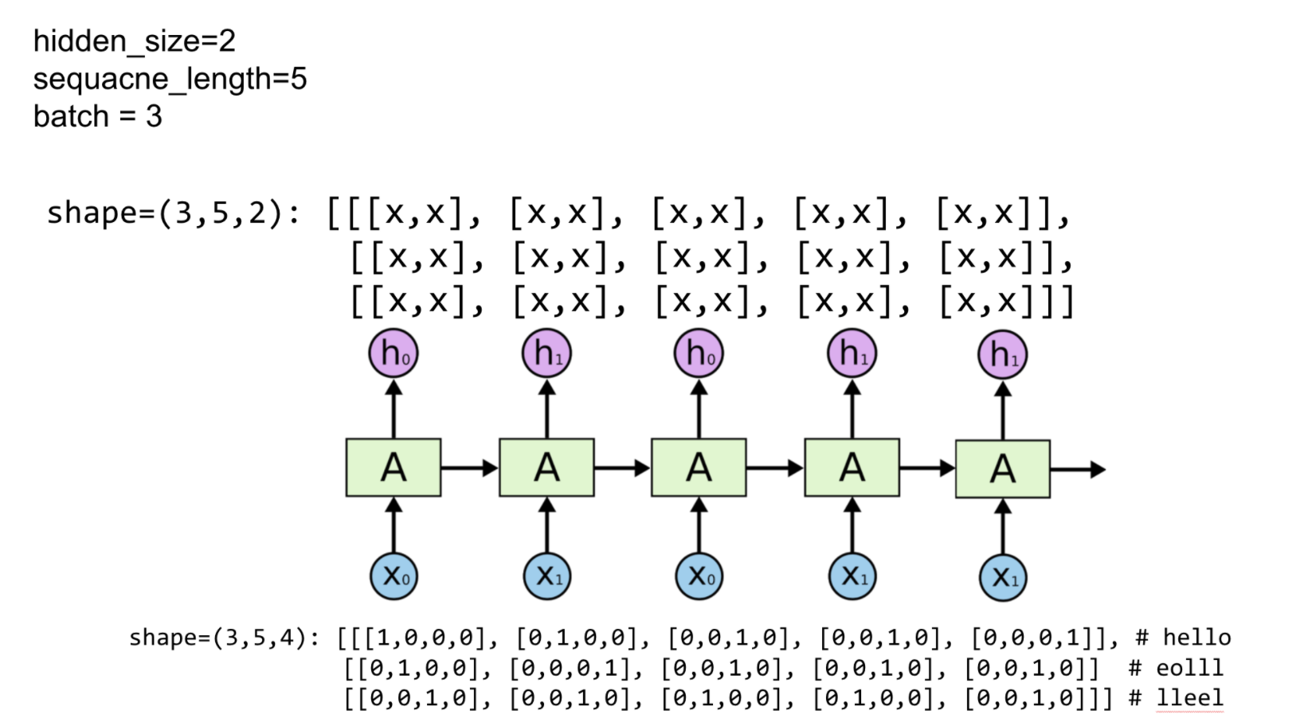
Batching input
Hidden_size=2
sequence_length=5
batch_size=3

Slide 13
Batching input
# One cell RNN input_dim (4) -> output_dim (2). sequence: 5, batch 3 # 3 batches 'hello', 'eolll', 'lleel' x_data = np.array([[h, e, l, l, o], [e, o, l, l, l], [l, l, e, e, l]], dtype=np.float32) pp.pprint(x_data) cell = rnn.BasicLSTMCell(num_units=2, state_is_tuple=True) outputs, _states = tf.nn.dynamic_rnn(cell, x_data,
dtype=tf.float32) sess.run(tf.global_variables_initializer()) pp.pprint(outputs.eval())
array([[[ 1., 0., 0., 0.], [ 0., 1., 0., 0.], [ 0., 0., 1., 0.], [ 0., 0., 1., 0.], [ 0., 0., 0., 1.]], [[ 0., 1., 0., 0.], [ 0., 0., 0., 1.], [ 0., 0., 1., 0.], [ 0., 0., 1., 0.], [ 0., 0., 1., 0.]], [[ 0., 0., 1., 0.], [ 0., 0., 1., 0.], [ 0., 1., 0., 0.], [ 0., 1., 0., 0.], [ 0., 0., 1., 0.]]],
Hidden_size=2
sequence_length=5
batch_size=3
https://github.com/hunkim/DeepLearningZeroToAll/blob/master/lab-12-0-rnn_basics.ipynb

Slide 14
Batching input
# One cell RNN input_dim (4) -> output_dim (2). sequence: 5, batch 3 # 3 batches 'hello', 'eolll', 'lleel' x_data = np.array([[h, e, l, l, o], [e, o, l, l, l], [l, l, e, e, l]], dtype=np.float32) pp.pprint(x_data) cell = rnn.BasicLSTMCell(num_units=2, state_is_tuple=True) outputs, _states = tf.nn.dynamic_rnn(cell, x_data,
dtype=tf.float32) sess.run(tf.global_variables_initializer()) pp.pprint(outputs.eval())
array([[[ 1., 0., 0., 0.], [ 0., 1., 0., 0.], [ 0., 0., 1., 0.], [ 0., 0., 1., 0.], [ 0., 0., 0., 1.]], [[ 0., 1., 0., 0.], [ 0., 0., 0., 1.], [ 0., 0., 1., 0.], [ 0., 0., 1., 0.], [ 0., 0., 1., 0.]], [[ 0., 0., 1., 0.], [ 0., 0., 1., 0.], [ 0., 1., 0., 0.], [ 0., 1., 0., 0.], [ 0., 0., 1., 0.]]],
array([[[-0.0173022 , -0.12929453], [-0.14995177, -0.23189341], [ 0.03294011, 0.01962204], [ 0.12852104, 0.12375218], [ 0.13597946, 0.31746736]], [[-0.15243632, -0.14177315], [ 0.04586344, 0.12249056], [ 0.14292534, 0.15872268], [ 0.18998367, 0.21004884], [ 0.21788891, 0.24151592]], [[ 0.10713603, 0.11001928], [ 0.17076059, 0.1799853 ], [-0.03531617, 0.08993293], [-0.1881337 , -0.08296411], [-0.00404597, 0.07156041]]],
Hidden_size=2
sequence_length=5
batch_size=3
https://github.com/hunkim/DeepLearningZeroToAll/blob/master/lab-12-0-rnn_basics.ipynb

Slide 15
Lab 12-2
Hi Hello RNN
With TF 1.0!
Sung Kim <hunkim+ml@gmail.com>
Code: https://github.com/hunkim/DeepLearningZeroToAll/

Slide 16
https://github.com/hunkim/DeepLearningZeroToAll/

Slide 17
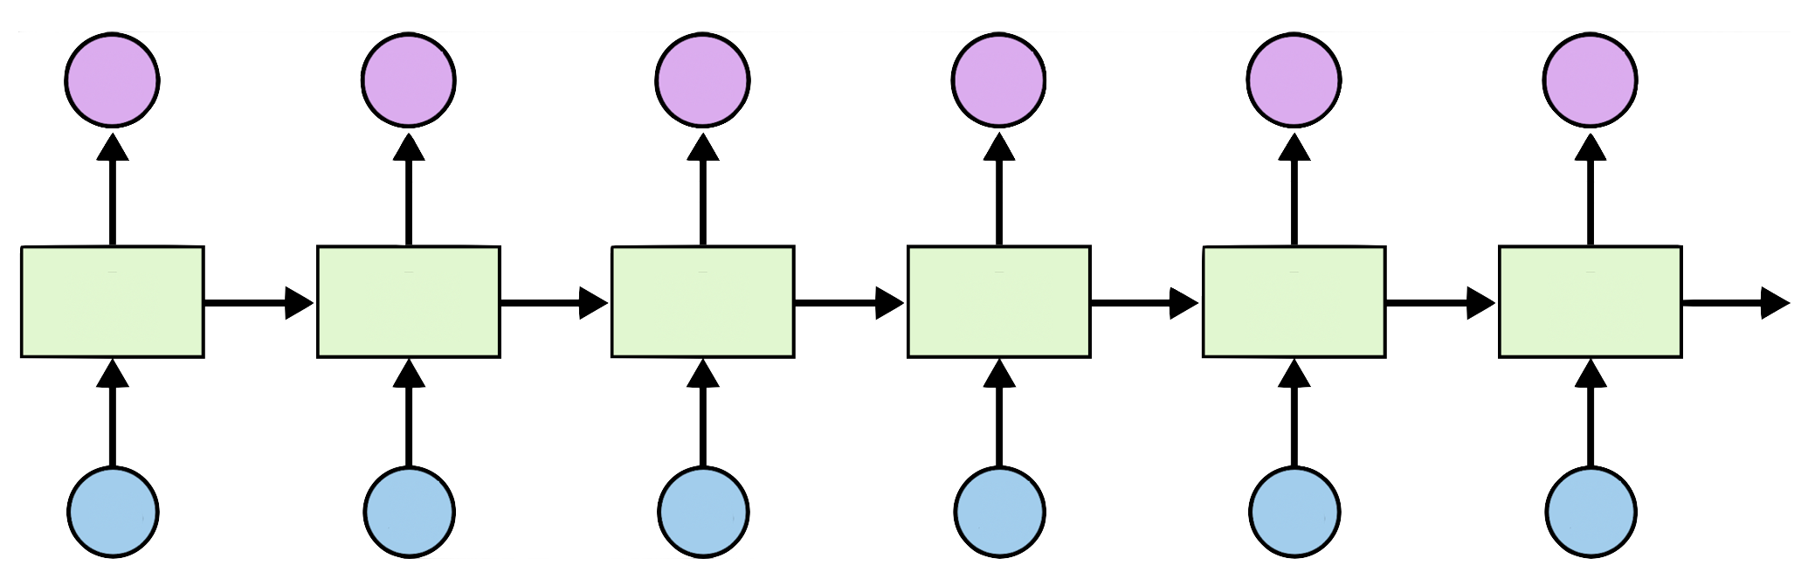
Teach RNN ‘hihello’
i
h
e
l
l
o
h
i
h
e
l
l

Slide 18
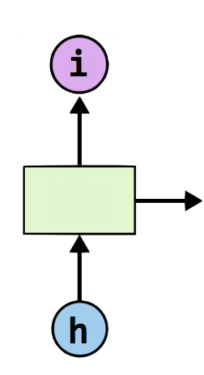
One-hot encoding
text: ‘hihello’
unique chars (vocabulary, voc):
h, i, e, l, o
voc index:
h:0, i:1, e:2, l:3, o:4
[1, 0, 0, 0, 0], # h 0
[0, 1, 0, 0, 0], # i 1
[0, 0, 1, 0, 0], # e 2
[0, 0, 0, 1, 0], # l 3
[0, 0, 0, 0, 1], # o 4

Slide 19
Teach RNN ‘hihello’
[1, 0, 0, 0, 0], # h 0
[0, 1, 0, 0, 0], # i 1
[0, 0, 1, 0, 0], # e 2
[0, 0, 0, 1, 0], # l 3
[0, 0, 0, 0, 1], # o 4
[0, 1, 0, 0, 0]
[1, 0, 0, 0, 0]
[0, 1, 0, 0, 0]
[0, 1, 0, 0, 0]
[0, 1, 0, 0, 0]
[0, 0, 0, 0, 1]
i
h
e
l
l
o
h
i
h
e
l
l
[1, 0, 0, 0, 0]
[0, 1, 0, 0, 0]
[1, 0, 0, 0, 0]
[0, 1, 0, 0, 0]
[0, 1, 0, 0, 0]
[0, 1, 0, 0, 0]

Slide 20
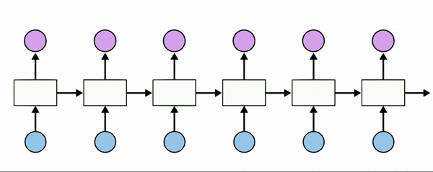
Teach RNN ‘hihello’
[1, 0, 0, 0, 0], # h 0
[0, 1, 0, 0, 0], # i 1
[0, 0, 1, 0, 0], # e 2
[0, 0, 0, 1, 0], # l 3
[0, 0, 0, 0, 1], # o 4

Slide 21
Creating rnn cell
# RNN model
rnn_cell = rnn_cell.BasicRNNCell(rnn_size)
rnn_cell = rnn_cell. BasicLSTMCell(rnn_size)
rnn_cell = rnn_cell. GRUCell(rnn_size)

Slide 22
Creating rnn cell
# RNN model
rnn_cell = rnn_cell.BasicRNNCell(rnn_size)
rnn_cell = rnn_cell. BasicLSTMCell(rnn_size)
rnn_cell = rnn_cell. GRUCell(rnn_size)

Slide 23


Execute RNN
hidden_rnn_size
# RNN model
rnn_cell = rnn_cell.BasicRNNCell(rnn_size)
outputs, _states = tf.nn.dynamic_rnn(
rnn_cell,
X,
initial_state=initial_state,
dtype=tf.float32)

Slide 24
RNN parameters
hidden_size = 5 # output from the LSTM
input_dim = 5 # one-hot size
batch_size = 1 # one sentence
sequence_length = 6 # |ihello| == 6
https://github.com/hunkim/DeepLearningZeroToAll/blob/master/lab-12-1-hello-rnn.py

Slide 25
Data creation
idx2char = ['h', 'i', 'e', 'l', 'o'] # h=0, i=1, e=2, l=3, o=4
x_data = [[0, 1, 0, 2, 3, 3]] # hihell
x_one_hot = [[[1, 0, 0, 0, 0], # h 0
[0, 1, 0, 0, 0], # i 1
[1, 0, 0, 0, 0], # h 0
[0, 0, 1, 0, 0], # e 2
[0, 0, 0, 1, 0], # l 3
[0, 0, 0, 1, 0]]] # l 3
y_data = [[1, 0, 2, 3, 3, 4]] # ihello
X = tf.placeholder(tf.float32,
[None, sequence_length, input_dim]) # X one-hot
Y = tf.placeholder(tf.int32, [None, sequence_length]) # Y label
https://github.com/hunkim/DeepLearningZeroToAll/blob/master/lab-12-1-hello-rnn.py

Slide 26
Feed to RNN
x_one_hot = [[[1, 0, 0, 0, 0], # h 0
[0, 1, 0, 0, 0], # i 1
[1, 0, 0, 0, 0], # h 0
[0, 0, 1, 0, 0], # e 2
[0, 0, 0, 1, 0], # l 3
[0, 0, 0, 1, 0]]] # l 3
y_data = [[1, 0, 2, 3, 3, 4]] # ihello
X = tf.placeholder(
tf.float32, [None, sequence_length, hidden_size]) # X one-hot
Y = tf.placeholder(tf.int32, [None, sequence_length]) # Y label
cell = tf.contrib.rnn.BasicLSTMCell(num_units=hidden_size, state_is_tuple=True)
initial_state = cell.zero_state(batch_size, tf.float32)
outputs, _states = tf.nn.dynamic_rnn(
cell, X, initial_state=initial_state, dtype=tf.float32)
https://github.com/hunkim/DeepLearningZeroToAll/blob/master/lab-12-1-hello-rnn.py

Slide 27
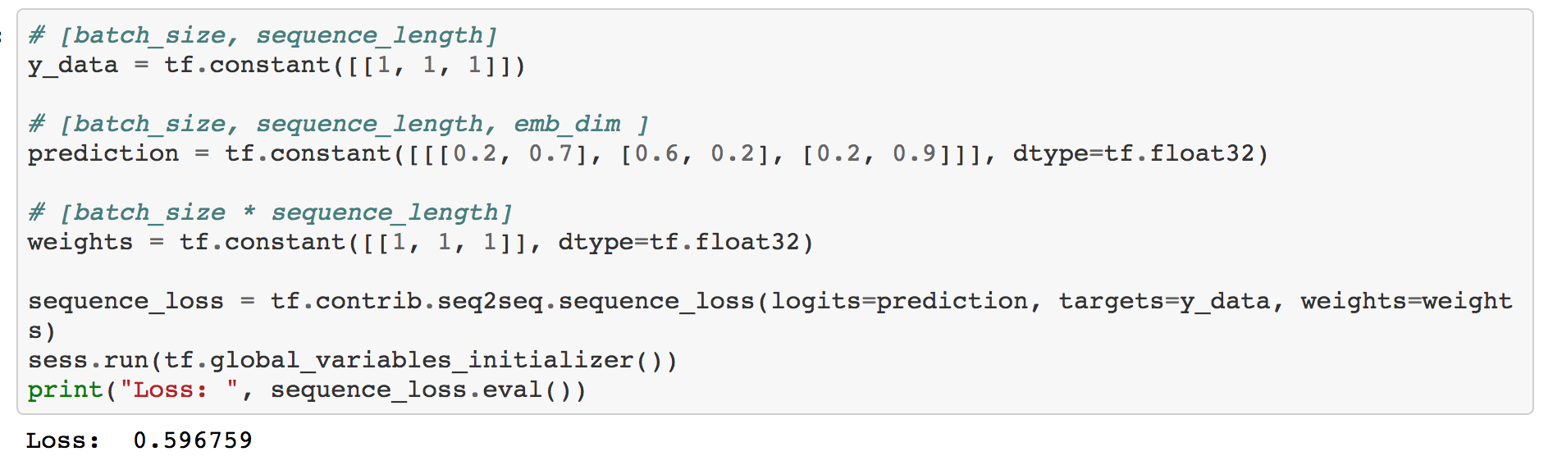
Cost: sequence_loss
https://github.com/hunkim/DeepLearningZeroToAll/blob/master/lab-12-0-rnn_basics.ipynb

Slide 28
Cost: sequence_loss
# [batch_size, sequence_length] y_data = tf.constant([[1, 1, 1]]) # [batch_size, sequence_length, emb_dim ] prediction1 = tf.constant([[[0.3, 0.7], [0.3, 0.7], [0.3, 0.7]]], dtype=tf.float32) prediction2 = tf.constant([[[0.1, 0.9], [0.1, 0.9], [0.1, 0.9]]], dtype=tf.float32) # [batch_size * sequence_length] weights = tf.constant([[1, 1, 1]], dtype=tf.float32) sequence_loss1 = tf.contrib.seq2seq.sequence_loss(prediction1, y_data, weights) sequence_loss2 = tf.contrib.seq2seq.sequence_loss(prediction2, y_data, weights) sess.run(tf.global_variables_initializer()) print("Loss1: ", sequence_loss1.eval(), "Loss2: ", sequence_loss2.eval())
Loss1: 0.513015
Loss2: 0.371101

Slide 29
Cost: sequence_loss
outputs, _states = tf.nn.dynamic_rnn(
cell, X, initial_state=initial_state, dtype=tf.float32)
weights = tf.ones([batch_size, sequence_length])
sequence_loss = tf.contrib.seq2seq.sequence_loss(
logits=outputs, targets=Y, weights=weights)
loss = tf.reduce_mean(sequence_loss)
train = tf.train.AdamOptimizer(learning_rate=0.1).minimize(loss)
https://github.com/hunkim/DeepLearningZeroToAll/blob/master/lab-12-1-hello-rnn.py

Slide 30
Training
prediction = tf.argmax(outputs, axis=2)
with tf.Session() as sess:
sess.run(tf.global_variables_initializer())
for i in range(2000):
l, _ = sess.run([loss, train], feed_dict={X: x_one_hot, Y: y_data})
result = sess.run(prediction, feed_dict={X: x_one_hot})
print(i, "loss:", l, "prediction: ", result, "true Y: ", y_data)
# print char using dic
result_str = [idx2char[c] for c in np.squeeze(result)]
print("\tPrediction str: ", ''.join(result_str))
https://github.com/hunkim/DeepLearningZeroToAll/blob/master/lab-12-1-hello-rnn.py

Slide 31
Results
prediction = tf.argmax(outputs, axis=2)
with tf.Session() as sess:
sess.run(tf.global_variables_initializer())
for i in range(2000):
l, _ = sess.run([loss, train], feed_dict={X: x_one_hot, Y: y_data})
result = sess.run(prediction, feed_dict={X: x_one_hot})
print(i, "loss:", l, "prediction: ", result, "true Y: ", y_data)
# print char using dic
result_str = [idx2char[c] for c in np.squeeze(result)]
print("\tPrediction str: ", ''.join(result_str))
0 loss: 1.55474 prediction: [[3 3 3 3 4 4]] true Y: [[1, 0, 2, 3, 3, 4]] Prediction str: lllloo
1 loss: 1.55081 prediction: [[3 3 3 3 4 4]] true Y: [[1, 0, 2, 3, 3, 4]] Prediction str: lllloo
2 loss: 1.54704 prediction: [[3 3 3 3 4 4]] true Y: [[1, 0, 2, 3, 3, 4]] Prediction str: lllloo
3 loss: 1.54342 prediction: [[3 3 3 3 4 4]] true Y: [[1, 0, 2, 3, 3, 4]] Prediction str: lllloo
...
1998 loss: 0.75305 prediction: [[1 0 2 3 3 4]] true Y: [[1, 0, 2, 3, 3, 4]] Prediction str: ihello
1999 loss: 0.752973 prediction: [[1 0 2 3 3 4]] true Y: [[1, 0, 2, 3, 3, 4]] Prediction str: ihello
https://github.com/hunkim/DeepLearningZeroToAll/blob/master/lab-12-1-hello-rnn.py

Slide 32
Lab 12-3
RNN with long sequences
With TF 1.0!
Sung Kim <hunkim+ml@gmail.com>
Code: https://github.com/hunkim/DeepLearningZeroToAll/

Slide 33
https://github.com/hunkim/DeepLearningZeroToAll/

Slide 34
Manual data creation
idx2char = ['h', 'i', 'e', 'l', 'o']
x_data = [[0, 1, 0, 2, 3, 3]] # hihell
x_one_hot = [[[1, 0, 0, 0, 0], # h 0
[0, 1, 0, 0, 0], # i 1
[1, 0, 0, 0, 0], # h 0
[0, 0, 1, 0, 0], # e 2
[0, 0, 0, 1, 0], # l 3
[0, 0, 0, 1, 0]]] # l 3
y_data = [[1, 0, 2, 3, 3, 4]] # ihello
https://github.com/hunkim/DeepLearningZeroToAll/blob/master/lab-12-1-hello-rnn.py

Slide 35
Better data creation
sample = " if you want you"
idx2char = list(set(sample)) # index -> char
char2idx = {c: i for i, c in enumerate(idx2char)} # char -> idx
sample_idx = [char2idx[c] for c in sample] # char to index
x_data = [sample_idx[:-1]] # X data sample (0 ~ n-1) hello: hell
y_data = [sample_idx[1:]] # Y label sample (1 ~ n) hello: ello
X = tf.placeholder(tf.int32, [None, sequence_length]) # X data
Y = tf.placeholder(tf.int32, [None, sequence_length]) # Y label
X_one_hot = tf.one_hot(X, num_classes) # one hot: 1 -> 0 1 0 0 0 0 0 0 0 0
https://github.com/hunkim/DeepLearningZeroToAll/blob/master/lab-12-2-char-seq-rnn.py

Slide 36
Hyper parameters
sample = " if you want you"
idx2char = list(set(sample)) # index -> char
char2idx = {c: i for i, c in enumerate(idx2char)} # char -> idx
# hyper parameters
dic_size = len(char2idx) # RNN input size (one hot size)
rnn_hidden_size = len(char2idx) # RNN output size
num_classes = len(char2idx) # final output size (RNN or softmax, etc.)
batch_size = 1 # one sample data, one batch
sequence_length = len(sample) - 1 # number of lstm unfolding (unit #)

Slide 37
LSTM and Loss
X = tf.placeholder(tf.int32, [None, sequence_length]) # X data
Y = tf.placeholder(tf.int32, [None, sequence_length]) # Y label
X_one_hot = tf.one_hot(X, num_classes) # one hot: 1 -> 0 1 0 0 0 0 0 0 0 0
cell = tf.contrib.rnn.BasicLSTMCell(num_units=rnn_hidden_size, state_is_tuple=True)
initial_state = cell.zero_state(batch_size, tf.float32)
outputs, _states = tf.nn.dynamic_rnn(
cell, X_one_hot, initial_state=initial_state, dtype=tf.float32)
weights = tf.ones([batch_size, sequence_length])
sequence_loss = tf.contrib.seq2seq.sequence_loss(logits=outputs, targets=Y,weights=weights)
loss = tf.reduce_mean(sequence_loss)
train = tf.train.GradientDescentOptimizer(learning_rate=0.1).minimize(loss)
prediction = tf.argmax(outputs, axis=2)
https://github.com/hunkim/DeepLearningZeroToAll/blob/master/lab-12-2-char-seq-rnn.py

Slide 38
Training and Results
with tf.Session() as sess:
sess.run(tf.global_variables_initializer())
for i in range(3000):
l, _ = sess.run([loss, train], feed_dict={X: x_data, Y: y_data})
result = sess.run(prediction, feed_dict={X: x_data})
# print char using dic
result_str = [idx2char[c] for c in np.squeeze(result)]
print(i, "loss:", l, "Prediction:", ''.join(result_str))
0 loss: 2.29895 Prediction: nnuffuunnuuuyuy
1 loss: 2.29675 Prediction: nnuffuunnuuuyuy
...
1418 loss: 1.37351 Prediction: if you want you
1419 loss: 1.37331 Prediction: if you want you
https://github.com/hunkim/DeepLearningZeroToAll/blob/master/lab-12-2-char-seq-rnn.py

Slide 39
Really long sentence?
sentence = ("if you want to build a ship, don't drum up people together to "
"collect wood and don't assign them tasks and work, but rather "
"teach them to long for the endless immensity of the sea.")
https://github.com/hunkim/DeepLearningZeroToAll/blob/master/lab-12-4-rnn_long_char.py

Slide 40
Really long sentence?
sentence = ("if you want to build a ship, don't drum up people together to "
"collect wood and don't assign them tasks and work, but rather "
"teach them to long for the endless immensity of the sea.")
# training dataset
0 if you wan -> f you want
1 f you want -> you want
2 you want -> you want t
3 you want t -> ou want to
…
168 of the se -> of the sea
169 of the sea -> f the sea.
https://github.com/hunkim/DeepLearningZeroToAll/blob/master/lab-12-4-rnn_long_char.py

Slide 41
Making dataset
char_set = list(set(sentence))
char_dic = {w: i for i, w in enumerate(char_set)}
dataX = []
dataY = []
for i in range(0, len(sentence) - seq_length):
x_str = sentence[i:i + seq_length]
y_str = sentence[i + 1: i + seq_length + 1]
print(i, x_str, '->', y_str)
x = [char_dic[c] for c in x_str] # x str to index
y = [char_dic[c] for c in y_str] # y str to index
dataX.append(x)
dataY.append(y)
# training dataset
0 if you wan -> f you want
1 f you want -> you want
2 you want -> you want t
3 you want t -> ou want to
…
168 of the se -> of the sea
169 of the sea -> f the sea.
https://github.com/hunkim/DeepLearningZeroToAll/blob/master/lab-12-4-rnn_long_char.py

Slide 42
RNN parameters
char_set = list(set(sentence))
char_dic = {w: i for i, w in enumerate(char_set)}
data_dim = len(char_set)
hidden_size = len(char_set)
num_classes = len(char_set)
seq_length = 10 # Any arbitrary number
batch_size = len(dataX)
# training dataset
0 if you wan -> f you want
1 f you want -> you want
2 you want -> you want t
3 you want t -> ou want to
…
168 of the se -> of the sea
169 of the sea -> f the sea.
https://github.com/hunkim/DeepLearningZeroToAll/blob/master/lab-12-4-rnn_long_char.py

Slide 43
LSTM and Loss
X = tf.placeholder(tf.int32, [None, sequence_length]) # X data
Y = tf.placeholder(tf.int32, [None, sequence_length]) # Y label
X_one_hot = tf.one_hot(X, num_classes) # one hot: 1 -> 0 1 0 0 0 0 0 0 0 0
cell = tf.contrib.rnn.BasicLSTMCell(num_units=rnn_hidden_size, state_is_tuple=True)
initial_state = cell.zero_state(batch_size, tf.float32)
outputs, _states = tf.nn.dynamic_rnn(
cell, X_one_hot, initial_state=initial_state, dtype=tf.float32)
weights = tf.ones([batch_size, sequence_length])
sequence_loss = tf.contrib.seq2seq.sequence_loss(logits=outputs, targets=Y,weights=weights)
loss = tf.reduce_mean(sequence_loss)
train = tf.train.GradientDescentOptimizer(learning_rate=0.1).minimize(loss)
prediction = tf.argmax(outputs, axis=2)
https://github.com/hunkim/DeepLearningZeroToAll/blob/master/lab-12-2-char-seq-rnn.py

Slide 44
Exercise
Run long sequence RNN
Why it does not work?

Slide 45
Lab 12-4
RNN with long sequences: Stacked RNN + Softmax layer
With TF 1.0!
Sung Kim <hunkim+ml@gmail.com>
Code: https://github.com/hunkim/DeepLearningZeroToAll/

Slide 46
https://github.com/hunkim/DeepLearningZeroToAll/

Slide 47
Really long sentence?
sentence = ("if you want to build a ship, don't drum up people together to "
"collect wood and don't assign them tasks and work, but rather "
"teach them to long for the endless immensity of the sea.")
https://github.com/hunkim/DeepLearningZeroToAll/blob/master/lab-12-4-rnn_long_char.py

Slide 48
Making dataset
char_set = list(set(sentence))
char_dic = {w: i for i, w in enumerate(char_set)}
dataX = []
dataY = []
for i in range(0, len(sentence) - seq_length):
x_str = sentence[i:i + seq_length]
y_str = sentence[i + 1: i + seq_length + 1]
print(i, x_str, '->', y_str)
x = [char_dic[c] for c in x_str] # x str to index
y = [char_dic[c] for c in y_str] # y str to index
dataX.append(x)
dataY.append(y)
# training dataset
0 if you wan -> f you want
1 f you want -> you want
2 you want -> you want t
3 you want t -> ou want to
…
168 of the se -> of the sea
169 of the sea -> f the sea.
https://github.com/hunkim/DeepLearningZeroToAll/blob/master/lab-12-4-rnn_long_char.py

Slide 49
RNN parameters
char_set = list(set(sentence))
char_dic = {w: i for i, w in enumerate(char_set)}
data_dim = len(char_set)
hidden_size = len(char_set)
num_classes = len(char_set)
seq_length = 10 # Any arbitrary number
batch_size = len(dataX)
# training dataset
0 if you wan -> f you want
1 f you want -> you want
2 you want -> you want t
3 you want t -> ou want to
…
168 of the se -> of the sea
169 of the sea -> f the sea.
https://github.com/hunkim/DeepLearningZeroToAll/blob/master/lab-12-4-rnn_long_char.py

Slide 50
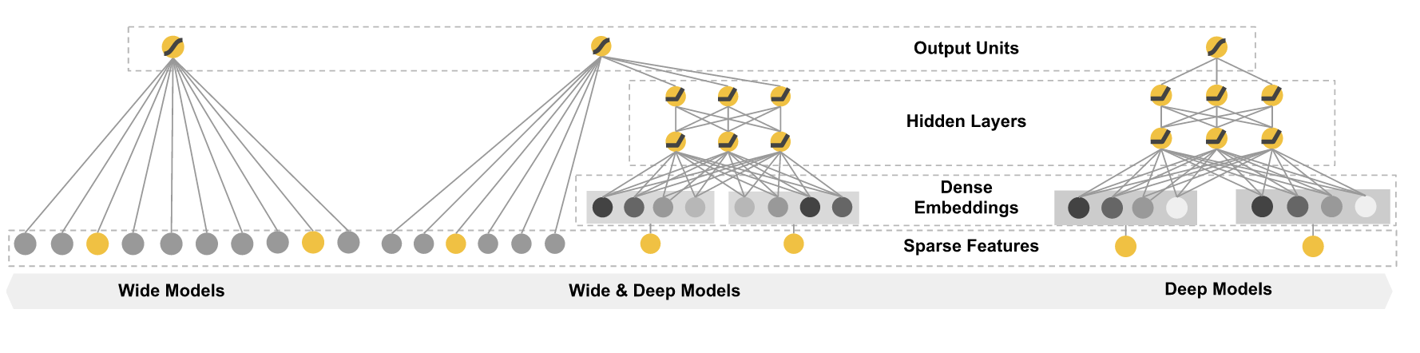
Wide & Deep
https://www.tensorflow.org/versions/r0.11/tutorials/wide_and_deep/index.html

Slide 51
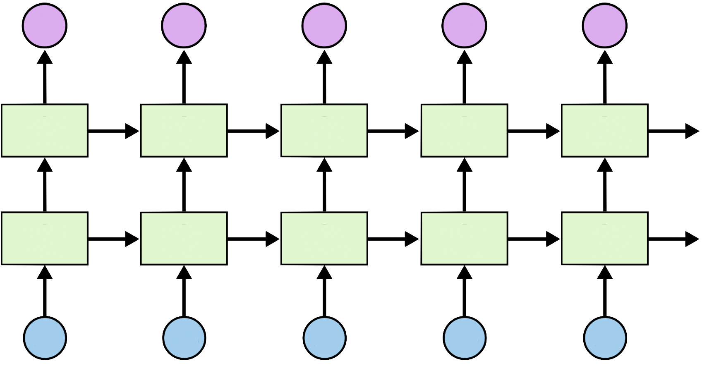
Stacked RNN
X = tf.placeholder(tf.int32, [None, seq_length])
Y = tf.placeholder(tf.int32, [None, seq_length])
# One-hot encoding
X_one_hot = tf.one_hot(X, num_classes)
print(X_one_hot) # check out the shape
# Make a lstm cell with hidden_size (each unit output vector size)
cell = rnn.BasicLSTMCell(hidden_size, state_is_tuple=True)
cell = rnn.MultiRNNCell([cell] * 2, state_is_tuple=True)
# outputs: unfolding size x hidden size, state = hidden size
outputs, _states = tf.nn.dynamic_rnn(cell, X_one_hot, dtype=tf.float32)
https://github.com/hunkim/DeepLearningZeroToAll/blob/master/lab-12-4-rnn_long_char.py

Slide 52
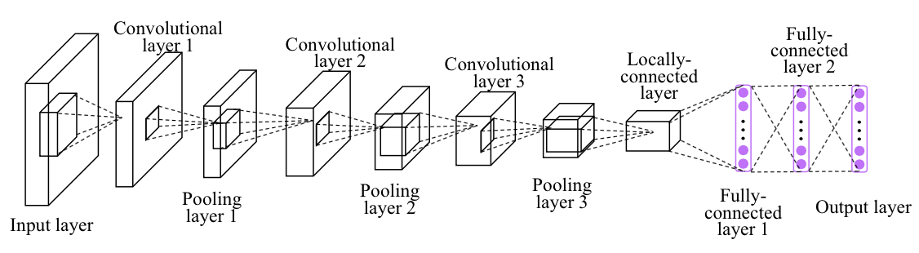
Softmax (FC) in Deep CNN
Image credit: http://personal.ie.cuhk.edu.hk/~ccloy/project_target_code/index.html

Slide 53
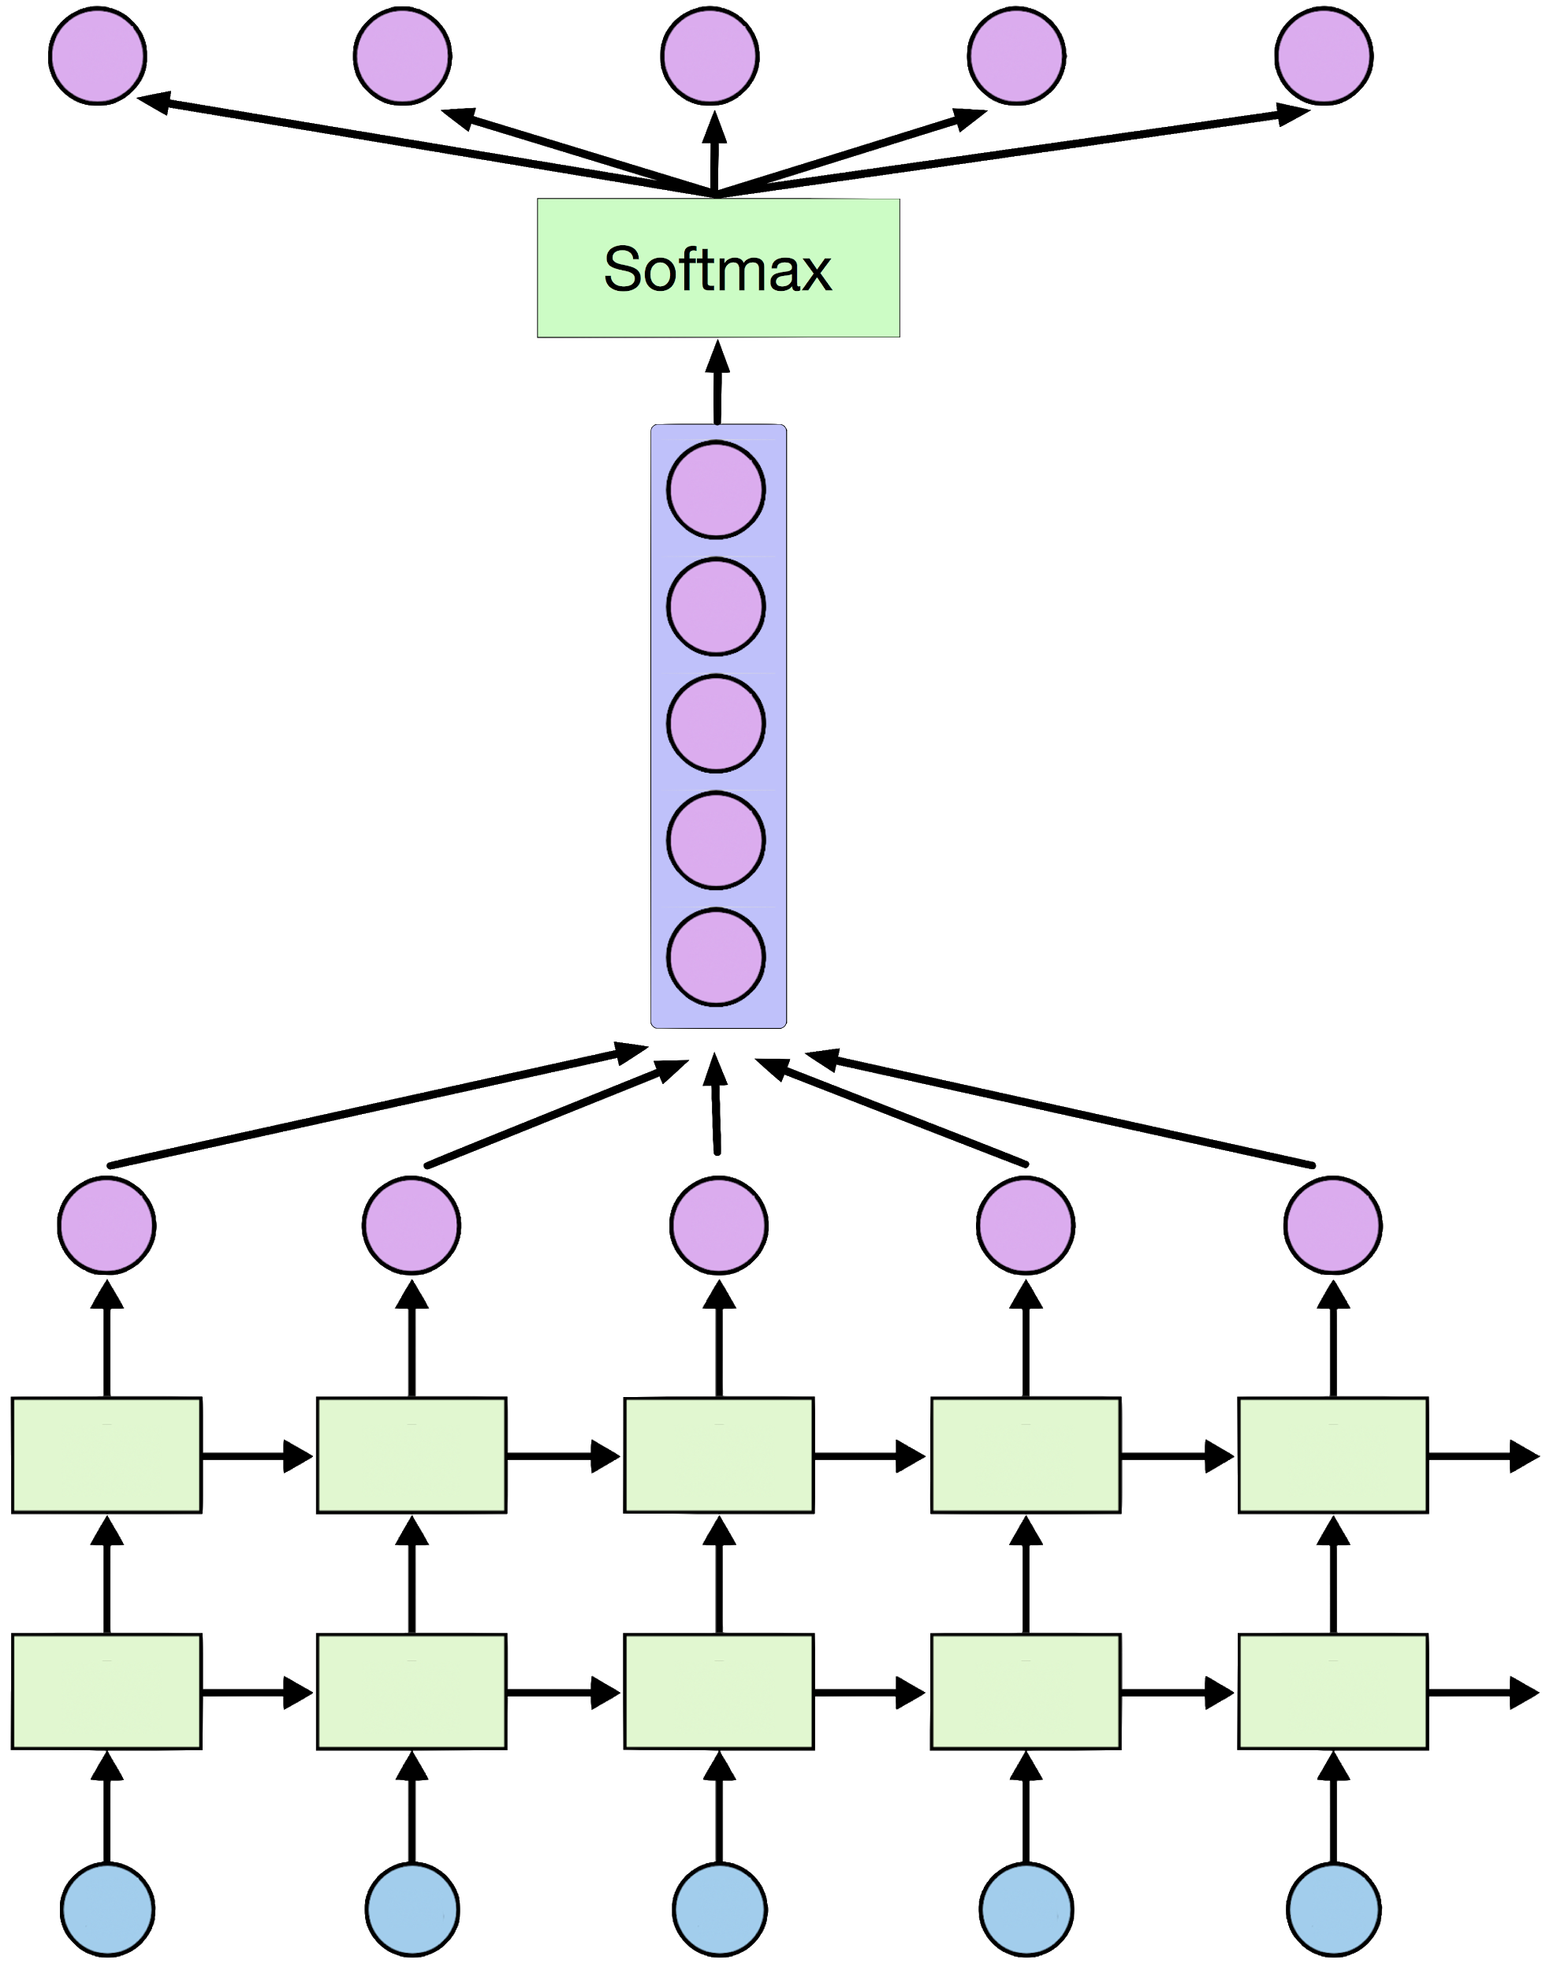
Softmax
https://github.com/hunkim/DeepLearningZeroToAll/blob/master/lab-12-4-rnn_long_char.py

Slide 54
Softmax
outputs = tf.reshape(outputs,
[batch_size, seq_length, num_classes])
X_for_softmax = tf.reshape(outputs,
[-1, hidden_size])
https://github.com/hunkim/DeepLearningZeroToAll/blob/master/lab-12-4-rnn_long_char.py

Slide 55
Softmax
# (optional) softmax layer
X_for_softmax = tf.reshape(outputs, [-1, hidden_size])
softmax_w = tf.get_variable("softmax_w",
[hidden_size, num_classes]
softmax_b = tf.get_variable("softmax_b",[num_classes])
outputs = tf.matmul(X_for_softmax,softmax_w) + softmax_b
outputs = tf.reshape(outputs,
[batch_size, seq_length, num_classes])
https://github.com/hunkim/DeepLearningZeroToAll/blob/master/lab-12-4-rnn_long_char.py

Slide 56
Loss
# reshape out for sequence_loss
outputs = tf.reshape(outputs,
[batch_size, seq_length, num_classes])
# All weights are 1 (equal weights)
weights = tf.ones([batch_size, seq_length])
sequence_loss = tf.contrib.seq2seq.sequence_loss(
logits=outputs, targets=Y, weights=weights)
mean_loss = tf.reduce_mean(sequence_loss)
train_op =
tf.train.AdamOptimizer(learning_rate=0.1).minimize(mean_loss)
https://github.com/hunkim/DeepLearningZeroToAll/blob/master/lab-12-4-rnn_long_char.py

Slide 57
Training and print results
0 167 tttttttttt 3.23111
0 168 tttttttttt 3.23111
0 169 tttttttttt 3.23111
…
499 167 oof the se 0.229306
499 168 tf the sea 0.229306
499 169 n the sea. 0.229306
sess = tf.Session()
sess.run(tf.global_variables_initializer()
for i in range(500):
_, l, results = sess.run(
[train_op, mean_loss, outputs],
feed_dict={X: dataX, Y: dataY})
for j, result in enumerate(results):
index = np.argmax(result, axis=1)
print(i, j, ''.join([char_set[t] for t in index]), l)
https://github.com/hunkim/DeepLearningZeroToAll/blob/master/lab-12-4-rnn_long_char.py

Slide 58
Training and print results
# Let's print the last char of each result to check it works
results = sess.run(outputs, feed_dict={X: dataX})
for j, result in enumerate(results):
index = np.argmax(result, axis=1)
if j is 0: # print all for the first result to make a sentence
print(''.join([char_set[t] for t in index]), end='')
else:
print(char_set[index[-1]], end='')
g you want to build a ship, don't drum up people together to collect wood and don't assign them tasks and work, but rather teach them to long for the endless immensity of the sea.
https://github.com/hunkim/DeepLearningZeroToAll/blob/master/lab-12-4-rnn_long_char.py

Slide 59
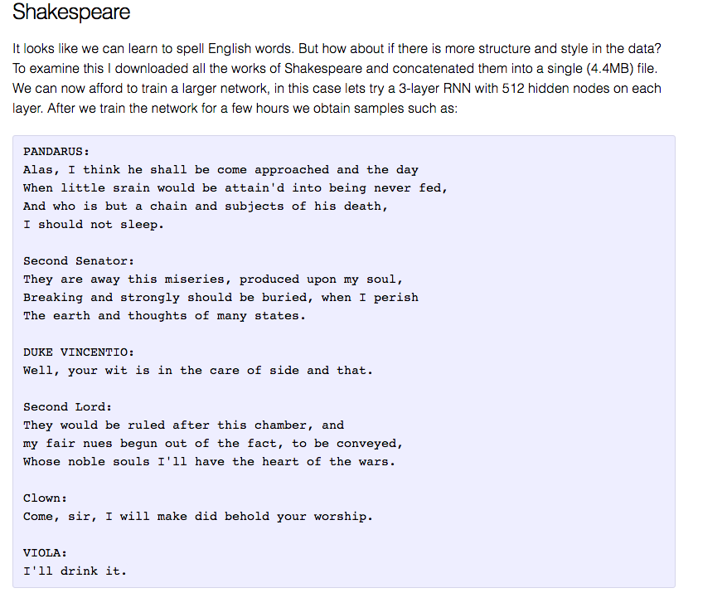
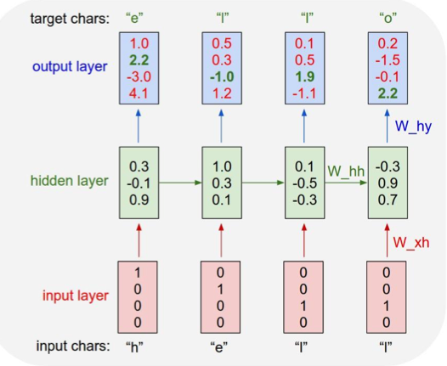
char-rnn
http://karpathy.github.io/2015/05/21/rnn-effectiveness/

Slide 60
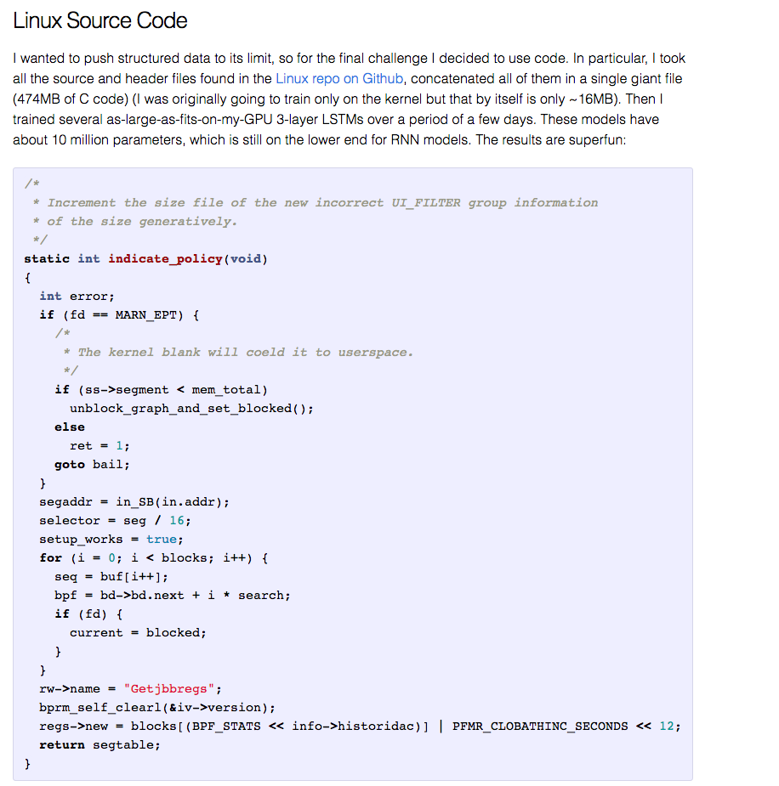
http://karpathy.github.io/2015/05/21/rnn-effectiveness/

Slide 61
char/word rnn (char/word level n to n model)
https://github.com/sherjilozair/char-rnn-tensorflow
https://github.com/hunkim/word-rnn-tensorflow

Slide 62
Lab 12-5
Dynamic RNN
With TF 1.0!
Sung Kim <hunkim+ml@gmail.com>
Code: https://github.com/hunkim/DeepLearningZeroToAll/

Slide 63
https://github.com/hunkim/DeepLearningZeroToAll/

Slide 64
Different sequence length
h e l l o
h i
w h y
...

Slide 65
Different sequence length
h e l l o
h i <pad> <pad> <pad>
w h y <pad> <pad>
...

Slide 66
Different sequence length
sequence_length=[5,2,3]
h e l l o
h i
w h y
...

Slide 67
Dynamic RNN
array([[[-0.17904168, -0.08053244], [-0.01294809, 0.01660814], [-0.05754048, -0.1368292 ], [-0.08655578, -0.20553185], [ 0.07297077, -0.21743253]], [[ 0.10272847, 0.06519825], [ 0.20188759, -0.05027055], [ 0.09514933, -0.16452041], [ 0. , 0. ], [ 0. , 0. ]], [[-0.04893036, -0.14655617], [-0.07947272, -0.20996611], [ 0.06466491, -0.02576563], [ 0.15087658, 0.05166111], [ 0. , 0. ]]],
# 3 batches 'hello', 'eolll', 'lleel' x_data = np.array([[[...]]], dtype=np.float32) hidden_size = 2 cell = rnn.BasicLSTMCell(num_units=hidden_size,
state_is_tuple=True) outputs, _states = tf.nn.dynamic_rnn( cell, x_data, sequence_length=[5,3,4],
dtype=tf.float32) sess.run(tf.global_variables_initializer()) print(outputs.eval())
https://github.com/hunkim/DeepLearningZeroToAll/blob/master/lab-12-0-rnn_basics.ipynb

Slide 68
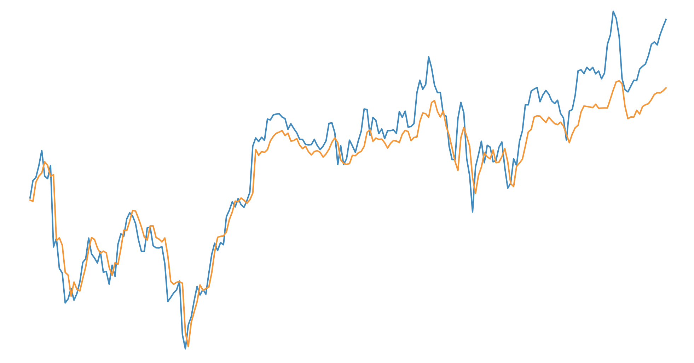
Lab 12-6
RNN with time series data (stock)
With TF 1.0!
Sung Kim <hunkim+ml@gmail.com>
Code: https://github.com/hunkim/DeepLearningZeroToAll/

Slide 69
https://github.com/hunkim/DeepLearningZeroToAll/

Slide 70
Time series data

Slide 71
Time series data
Open | High | Low | Volume | Close
828.659973 | 833.450012 | 828.349976 | 1247700 | 831.659973
823.02002 | 828.070007 | 821.655029 | 1597800 | 828.070007
819.929993 | 824.400024 | 818.97998 | 1281700 | 824.159973
819.359985 | 823 | 818.469971 | 1304000 | 818.97998
819 | 823 | 816 | 1053600 | 820.450012
816 | 820.958984 | 815.48999 | 1198100 | 819.23999
811.700012 | 815.25 | 809.780029 | 1129100 | 813.669983
809.51001 | 810.659973 | 804.539978 | 989700 | 809.559998
807 | 811.840027 | 803.190002 | 1155300 | 808.380005
'data-02-stock_daily.csv'

Slide 72
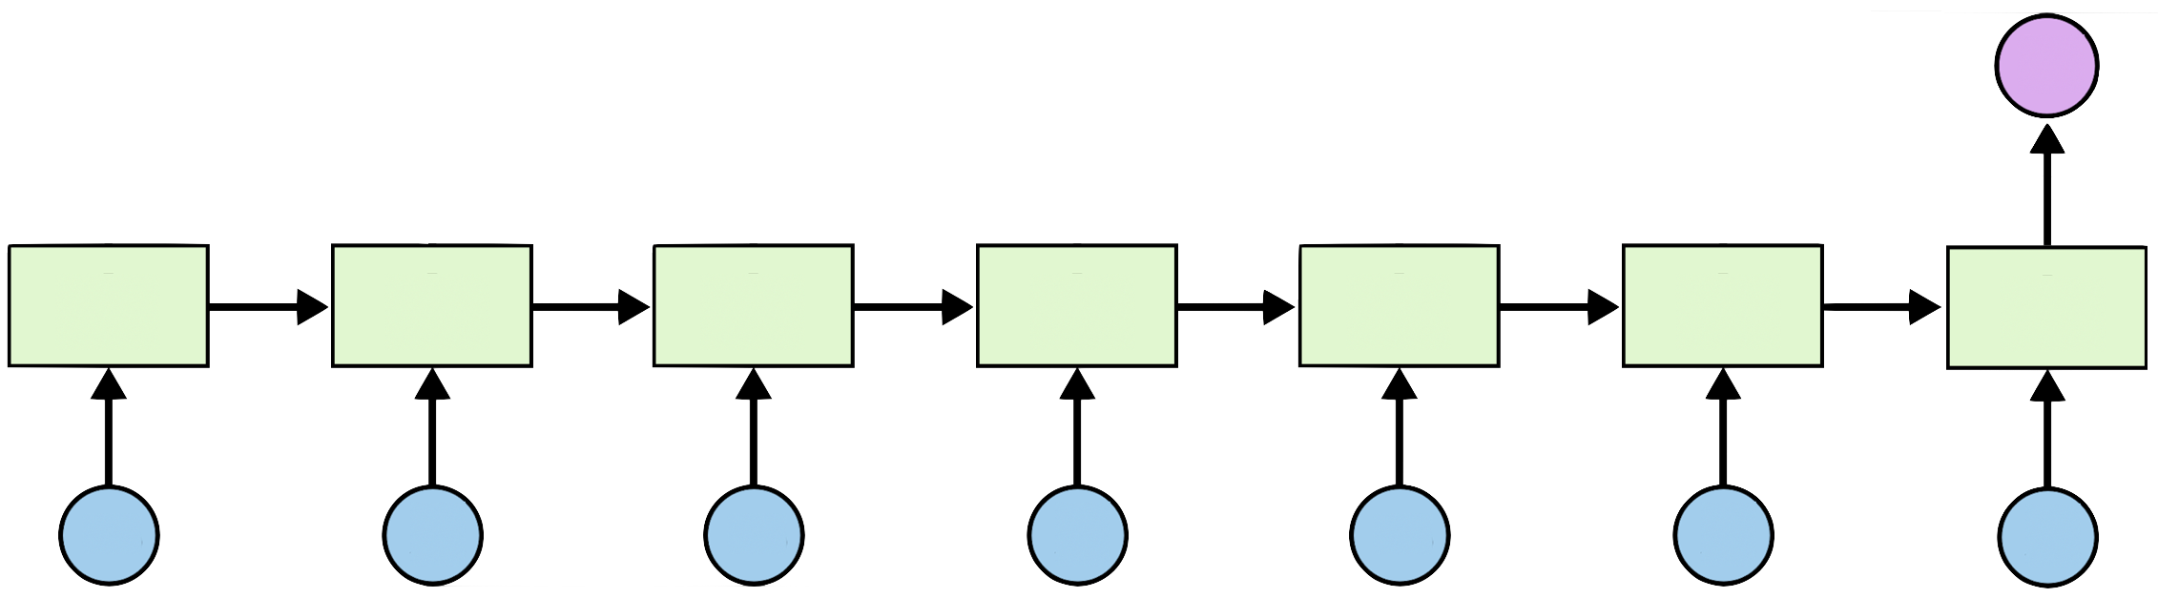
Many to one
8
1
2
3
4
5
6
7
https://github.com/hunkim/DeepLearningZeroToAll/blob/master/lab-12-5-rnn_stock_prediction.py

Slide 73
Open | High | Low | Volume | Close
828.659973 | 833.450012 | 828.349976 | 1247700 | 831.659973
823.02002 | 828.070007 | 821.655029 | 1597800 | 828.070007
819.929993 | 824.400024 | 818.97998 | 1281700 | 824.159973
819.359985 | 823 | 818.469971 | 1304000 | 818.97998
819 | 823 | 816 | 1053600 | 820.450012
816 | 820.958984 | 815.48999 | 1198100 | 819.23999
811.700012 | 815.25 | 809.780029 | 1129100 | 813.669983
809.51001 | 810.659973 | 804.539978 | 989700 | ?
807 | 811.840027 | 803.190002 | 1155300 | ?

Slide 74
Reading data
timesteps = seq_length = 7
data_dim = 5
output_dim = 1
# Open,High,Low,Close,Volume
xy = np.loadtxt('data-02-stock_daily.csv', delimiter=',')
xy = xy[::-1] # reverse order (chronically ordered)
xy = MinMaxScaler(xy)
x = xy
y = xy[:, [-1]] # Close as label
dataX = []
dataY = []
for i in range(0, len(y) - seq_length):
_x = x[i:i + seq_length]
_y = y[i + seq_length] # Next close price
print(_x, "->", _y)
dataX.append(_x)
dataY.append(_y)
[[ 0.18667876 0.20948057 0.20878184 0. 0.21744815]
[ 0.30697388 0.31463414 0.21899367 0.01247647 0.21698189]
[ 0.21914211 0.26390721 0.2246864 0.45632338 0.22496747]
[ 0.23312993 0.23641916 0.16268272 0.57017119 0.14744274]
[ 0.13431201 0.15175877 0.11617252 0.39380658 0.13289962]
[ 0.13973232 0.17060429 0.15860382 0.28173344 0.18171679]
[ 0.18933069 0.20057799 0.19187983 0.29783096 0.2086465 ]]
--> [ 0.14106001]
https://github.com/hunkim/DeepLearningZeroToAll/blob/master/lab-12-5-rnn_stock_prediction.py

Slide 75
Training and test datasets
# split to train and testing
train_size = int(len(dataY) * 0.7)
test_size = len(dataY) - train_size
trainX, testX = np.array(dataX[0:train_size]),
np.array(dataX[train_size:len(dataX)])
trainY, testY = np.array(dataY[0:train_size]),
np.array(dataY[train_size:len(dataY)])
# input placeholders
X = tf.placeholder(tf.float32, [None, seq_length, data_dim])
Y = tf.placeholder(tf.float32, [None, 1])
https://github.com/hunkim/DeepLearningZeroToAll/blob/master/lab-12-5-rnn_stock_prediction.py

Slide 76
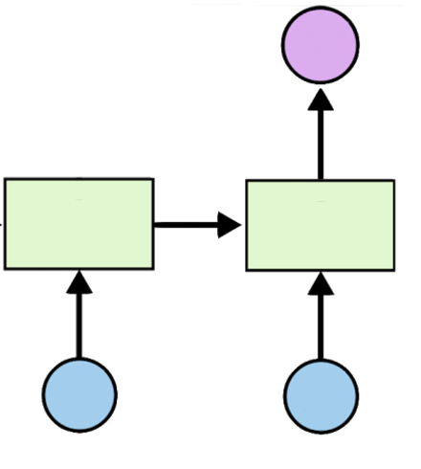
LSTM and Loss
# input placeholders
X = tf.placeholder(tf.float32, [None, seq_length, data_dim])
Y = tf.placeholder(tf.float32, [None, 1])
cell = tf.contrib.rnn.BasicLSTMCell(num_units=hidden_dim, state_is_tuple=True)
outputs, _states = tf.nn.dynamic_rnn(cell, X, dtype=tf.float32)
Y_pred = tf.contrib.layers.fully_connected(
outputs[:, -1], output_dim, activation_fn=None)
# We use the last cell's output
# cost/loss
loss = tf.reduce_sum(tf.square(Y_pred - Y)) # sum of the squares
# optimizer
optimizer = tf.train.AdamOptimizer(0.01)
train = optimizer.minimize(loss)
https://github.com/hunkim/DeepLearningZeroToAll/blob/master/lab-12-5-rnn_stock_prediction.py

Slide 77
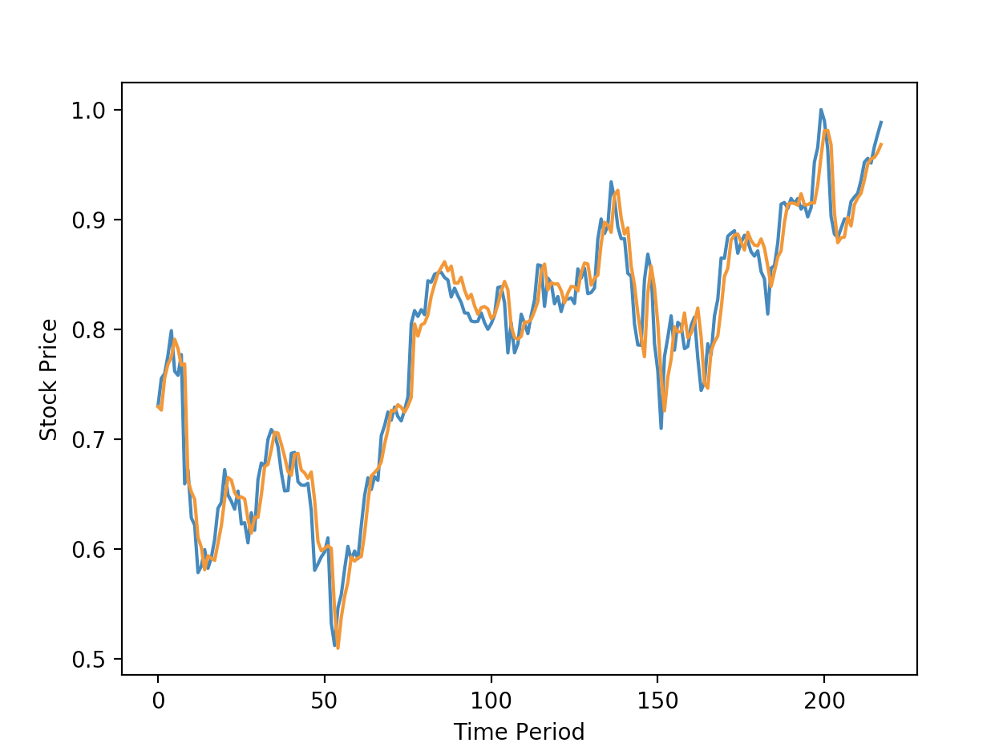
Training and Results
sess = tf.Session()
sess.run(tf.global_variables_initializer())
for i in range(1000):
_, l = sess.run([train, loss],
feed_dict={X: trainX, Y: trainY})
print(i, l)
testPredict = sess.run(Y_pred, feed_dict={X: testX})
import matplotlib.pyplot as plt
plt.plot(testY)
plt.plot(testPredict)
plt.show()
https://github.com/hunkim/DeepLearningZeroToAll/blob/master/lab-12-5-rnn_stock_prediction.py

Slide 78
Exercise
Implement stock prediction using linear regression only
Improve results using more features such as keywords and/or sentiments in top news

Slide 79
Other RNN applications
Language Modeling
Speech Recognition
Machine Translation
Conversation Modeling/Question Answering
Image/Video Captioning
Image/Music/Dance Generation
http://jiwonkim.org/awesome-rnn/

